Slide 1

6th Grade Math
Unit 12, Lesson 10 Solving One-Step Multiplication and Division Equations in One Variable Using Manipulatives Volume 2, pg. 332

Slide 2


Benchmark
MA.6.AR.2.3
Write and solve one-step equations in one variable within a mathematical or real-world context using multiplication and division, where all terms and solutions are integers.
volume 2, pg. 332

Slide 3
Integrated Mathematical Thinking and Reasoning Standards
MA.K12.MTR.1.1 Actively participate in effortful learning both individually and collectively.
MA.K12.MTR.2.1 Demonstrate understanding by representing problems in multiple ways.
MA.K12.MTR.4.1 Engage in discussions that reflect on the mathematical thinking of self and others.
MA.K12.MTR.5.1 Use patterns and structure to help understand and connect mathematical concepts.
volume 2, pg. 332

Slide 4

Learning Target
I can solve one-step multiplication and division equations using manipulatives.
volume 2, pg. 332

Slide 5

Warm-Up
volume 2, pg. 333

Slide 6
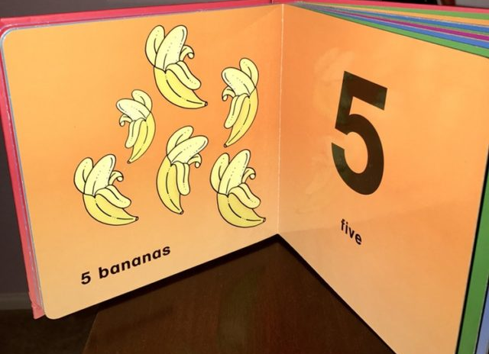
12.10.1 Warm-Up: Math Fail
This children’s book has published a “math fail.”
Explain the error shown in this image.
volume 2, pg. 333

Slide 7

Exploration
volume 2, pg. 333

Slide 8
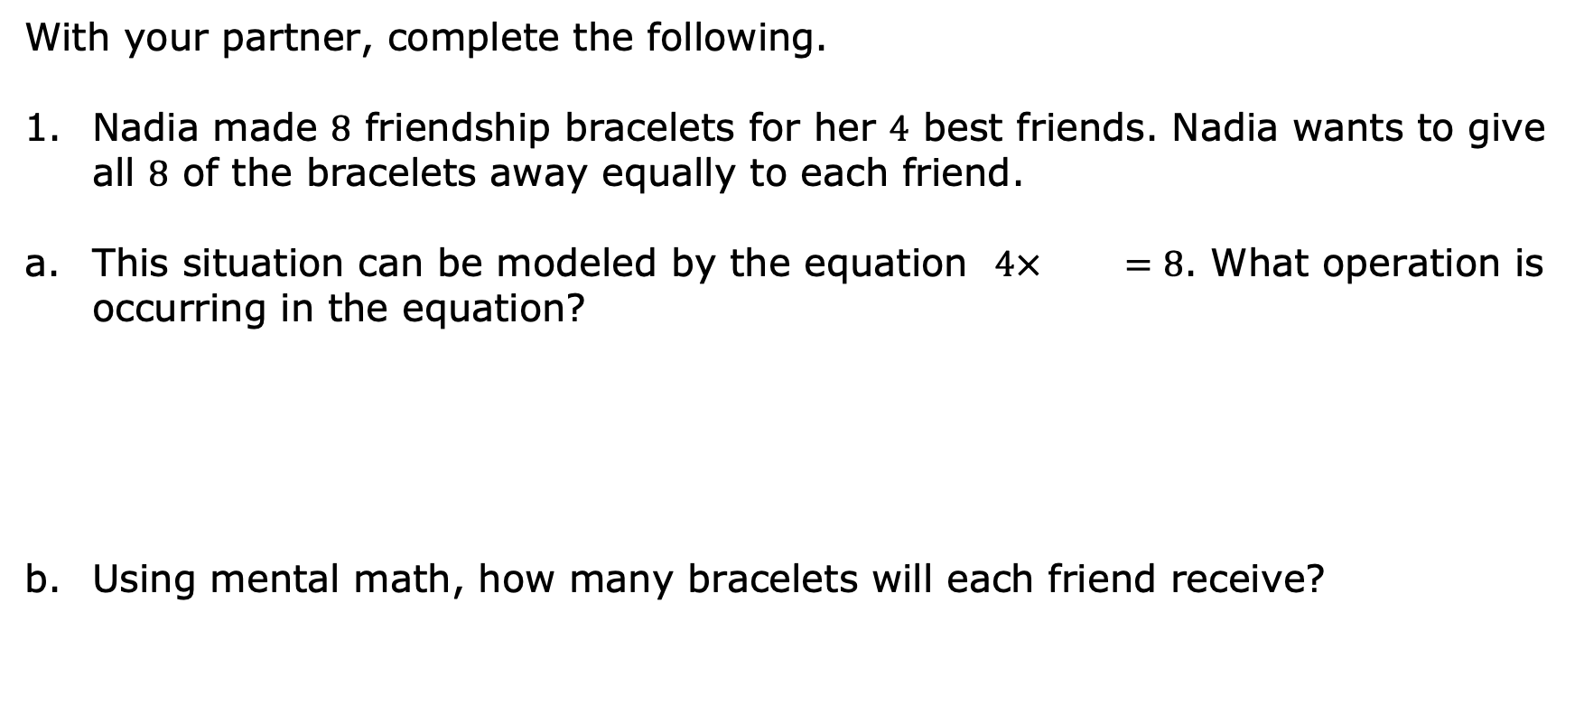
12.10.2 Exploration: Exploring Relationships
volume 2, pg. 333

Slide 9
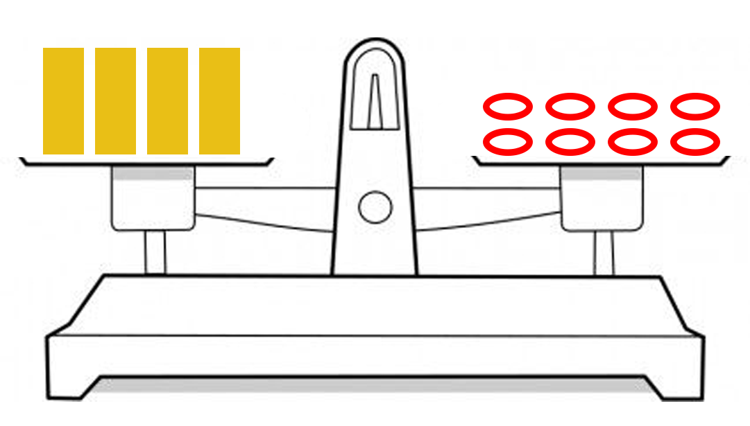
This situation can also be represented using a balance scale. The rectangles represent Nadia’s friends and the ovals represent the bracelets.
volume 2, pg. 333

Slide 10
Using the rectangles and ovals, sketch an image that demonstrates how many bracelets each friend will receive.
What operation does your sketch demonstrate?
volume 2, pg. 334

Slide 11
How many bracelets will each friend receive?
Discuss what you notice about the operation included in the equation and the operation you used to find the number of bracelets each friend will receive. Summarize your discussion.
Recall that when solving an equation, the mathematical sentence must remain balanced so that the two expressions remain equivalent.
volume 2, pg. 334

Slide 12
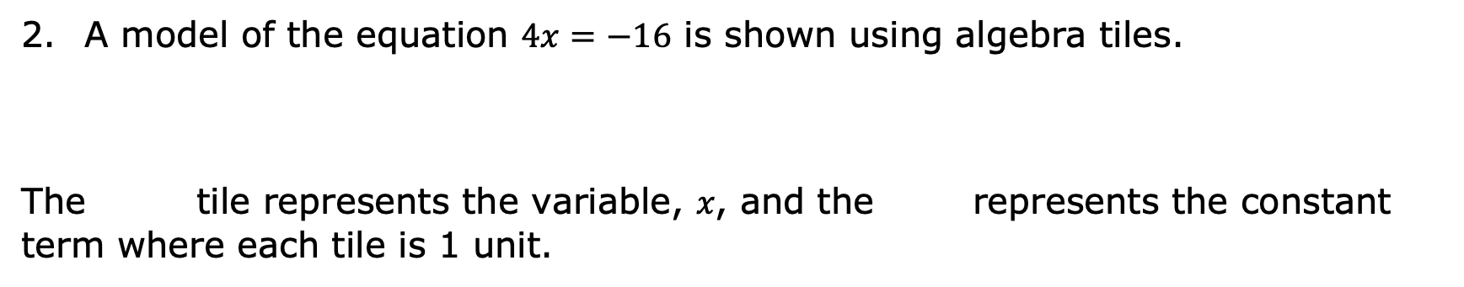


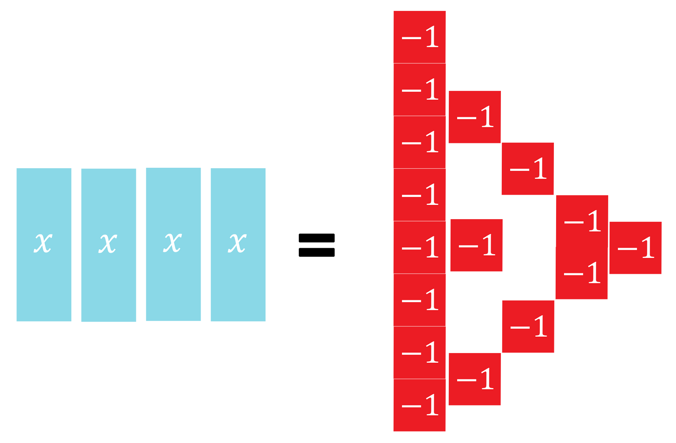
volume 2, pg. 334

Slide 13
volume 2, pg. 334

Slide 14
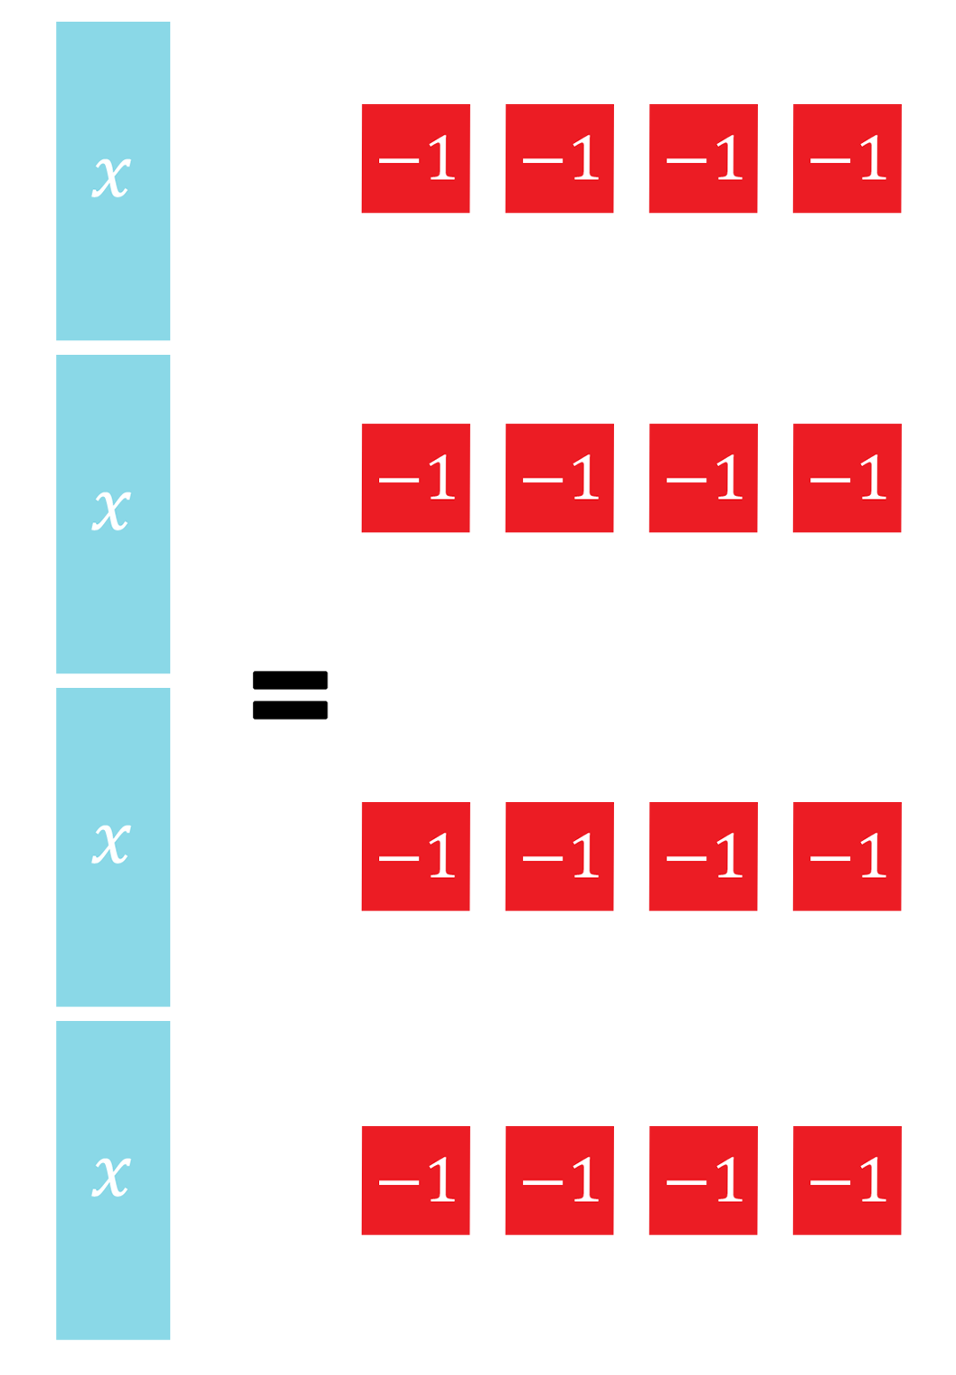
The algebra tiles are arranged on the equation mat into equal-sized groups on both sides of the equation. How many groups were created?
volume 2, pg. 335

Slide 15
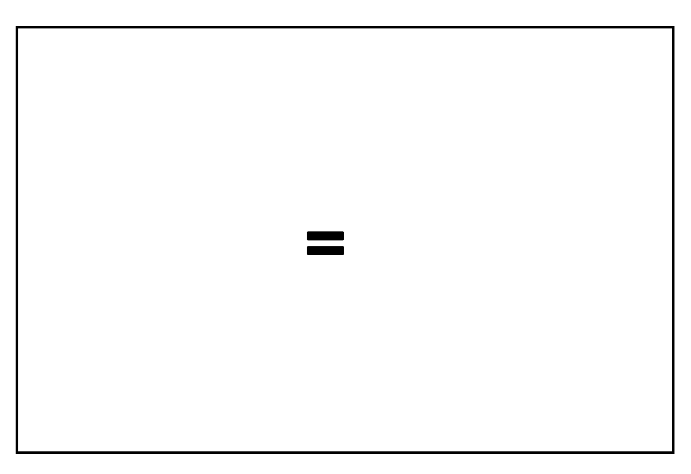
Use algebra tiles to sketch the solution of the equation.
What is the value of 𝑥?
volume 2, pg. 335

Slide 16
Inverse operations can be helpful in solving equations.
Draw an arrow to match each operation on the left with its inverse operation on the right.
division | division
addition | addition
subtraction | subtraction
multiplication | multiplication
volume 2, pg. 335

Slide 17
Explain what it means for operations to be inverses.
Which inverse operations were used to solve the equations in this exploration?
volume 2, pg. 335

Slide 18

Guided Instruction
volume 2, pg. 336

Slide 19
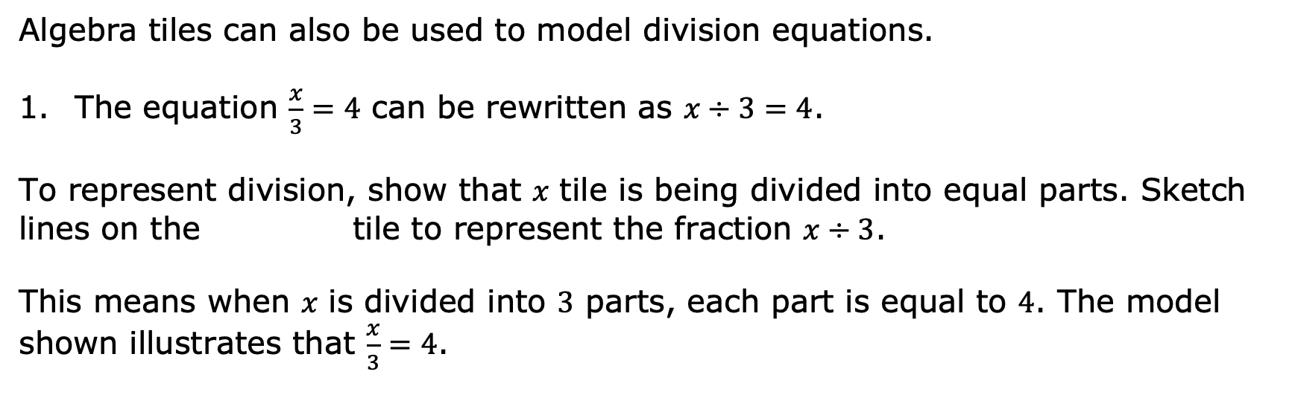
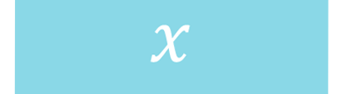
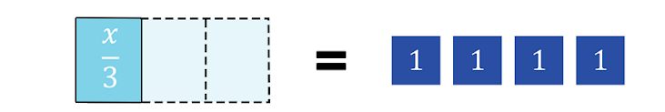
12.10.3 Guided Instruction: Modeling the Inverse of Division
volume 2, pg. 336

Slide 20
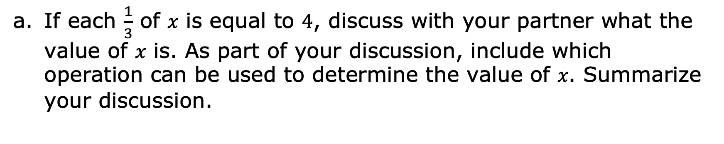
volume 2, pg. 336

Slide 21
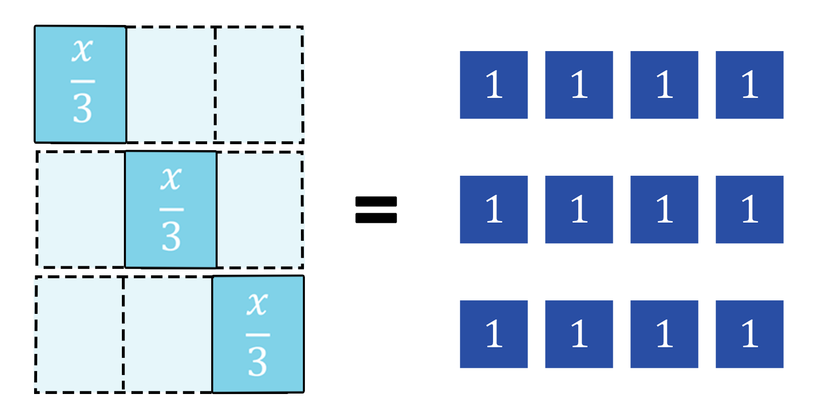
The image models the relationship discussed that can be used to determine the value of 𝑥.
Explain how this representation can be used to determine the value of .
volume 2, pg. 336

Slide 22
What is the value of 𝑥?
Complete the statements by writing operations on each blank.
The original equation involved the operation _____________________. Its inverse operation, _____________________, was used to solve the equation.
volume 2, pg. 336

Slide 23

Guided Practice
volume 2, pg. 337

Slide 24
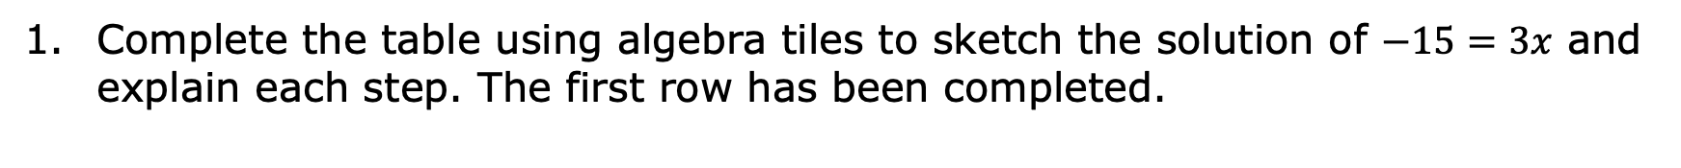
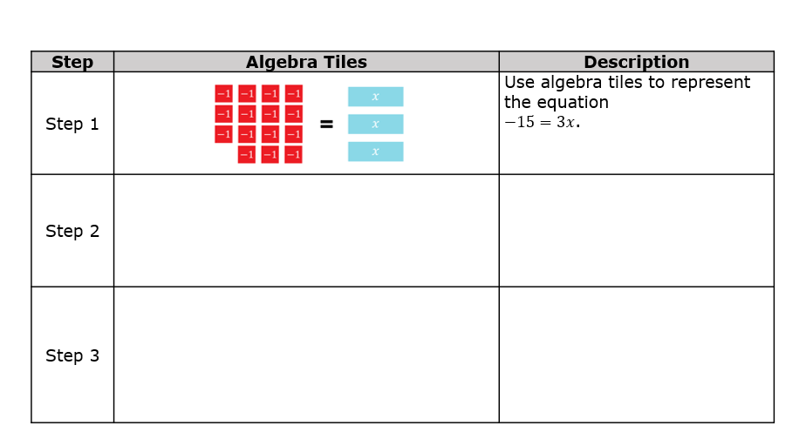
12.10.4 Guided Practice: Solving Equations Using Manipulatives
volume 2, pg. 337

Slide 25
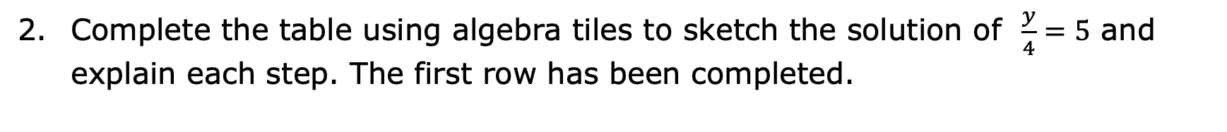
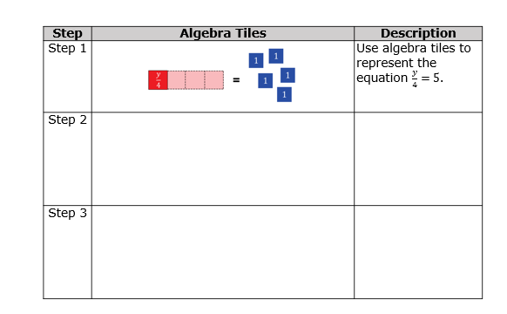
volume 2, pg. 337

Slide 26

Your Turn
volume 2, pg. 338

Slide 27
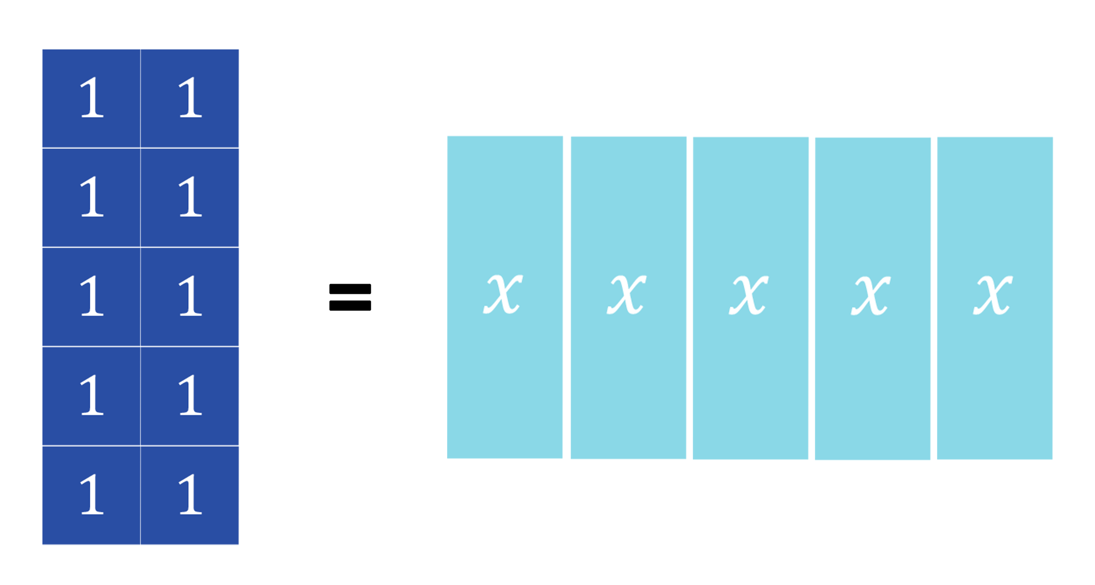
12.10.5 Your Turn!
volume 2, pg. 338

Slide 28
Explain whether you agree with Miranda.
Sketch the next step in determining the solution to the equation.
volume 2, pg. 338

Slide 29
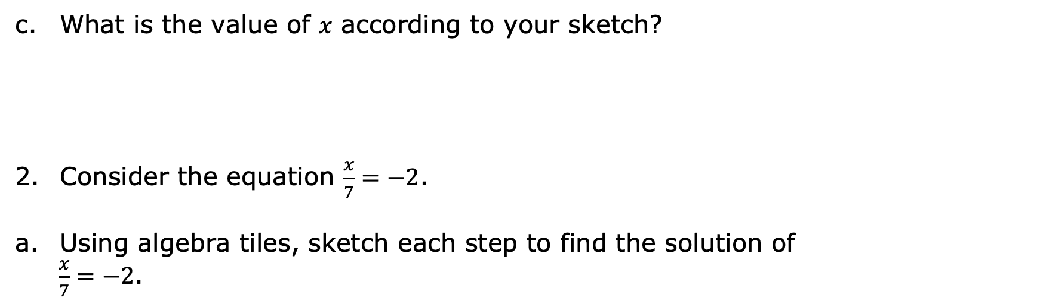
Step 1
volume 2, pg. 338

Slide 30
Step 2
Step 3
volume 2, pg. 339

Slide 31
What is the value of 𝑥 according to your sketch?
volume 2, pg. 339

Slide 32

Wrap-Up
volume 2, pg. 339

Slide 33
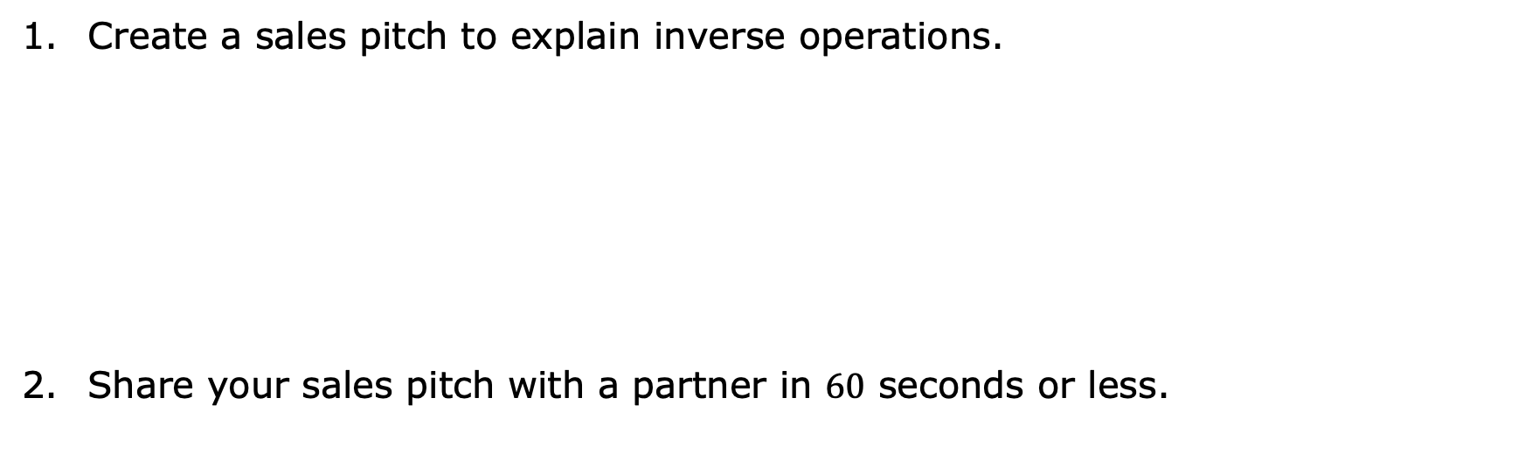
12.10.6 Wrap-Up: Cool Down
volume 2, pg. 339

